Slide 1




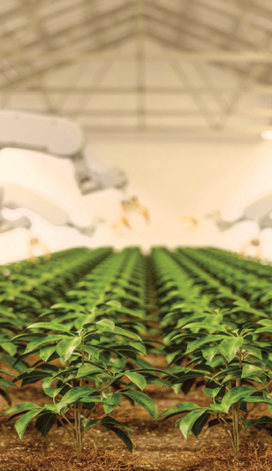

Reimagining Family Capital
Prepared by:
Dr James Gifford, PhD.
james.gifford@additionality.co
+41791557789
20 August 2025
Skills, strategy and sustainable impact
Proposal for family education on wealth and impact

Slide 2
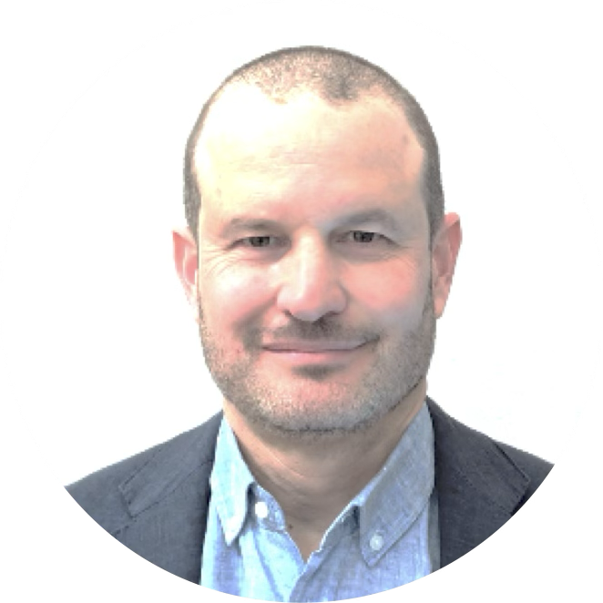

Message from
Dr James Gifford
We stand at an unprecedented crossroads in history, where the choices we make today have profound implications for generations to come.
For affluent families, these decisions are not just about wealth preservation but about shaping the future in alignment with your deepest values and aspirations.
Impact investing represents a powerful opportunity to combine the rigorous discipline of investment management with the transformative potential of sustainable and impact strategies.
Over the past decade, I have witnessed firsthand how impact investing empowers next-generation wealth holders.
As co-founder and lead faculty of the "Impact Investing for the Next Generation" executive program, originally at Harvard and now at MIT and the University of Zurich – along with leading impact investing at UBS and Credit Suisse – I have worked with over 300 UHNW family members globally.
This experience has consistently shown that integrating impact investing strategies provides profound benefits for families, including enhanced family cohesion, meaningful engagement across generations, development of new areas of expertise, and a renewed sense of purpose in wealth stewardship.
I look forward to exploring how I can support you on this journey.
Best regards,
Dr James Gifford
Founder and CEO

Slide 3
Honouring your legacy, igniting the next chapter
With new generations stepping forward and professional management increasingly in place, families face a pivotal moment: how to shape their capital so it reflects shared values, strengthens unity, and creates opportunities for the future. The decisions made now will define both family cohesion and the role families play in addressing global challenges.
This masterclass is designed to support families at this juncture. It blends the discipline of investment with the inspiration of impact, where purpose meets profit — from venture capital in climate tech and AI for development to new business models for inclusive growth. And doing this across asset classes to bring sustainability into a whole-of-portfolio approach.
For the next generation, this is an agenda to explore emerging sectors and themes, develop investment skills and networks, and contribute to the family’s strategic direction.
For the family as a whole, it is a chance to create an expanded and positive vision of the future, building on legacy and values, and creating a roadmap for investments that deliver financial returns and measurable impact. In doing so, families can position themselves as leaders not only in business, but also in shaping the future of impact investing.

Slide 4

Why leverage impact investing for your family?
By embarking on this impact investment journey, your family will gain:
A deeper understanding of the key global trends and pressing social and environmental issues.
Clear ways forward for constructing a sustainable and impactful portfolio for the family office and foundation.
Knowledge of investable opportunities in sustainability and impact investing.
Enhanced family governance structures, ensuring clarity and unity around your investment vision and values.
Practical skills and tools to assess, manage, and maximise impact in investments.
Opportunities for experiential learning and skills development through engaging directly with innovative investments.

Slide 5
Proposed masterclass
Potential Itinerary
 | Arrive morning Afternoon preparation and dinner
Day 1 | Masterclass Day 1 (with peer families, optional) Optional group dinner
Day 2 | Masterclass Day 2 (family only) Optional family dinner
Day 3 | Implementation and strategy discussions (key family members and advisors)
 | Depart afternoon
To support your family in making informed and impactful investment decisions, Additionality Capital proposes a customised, in-person masterclass designed specifically for your context.
This masterclass can serve to bring everyone onto the same page, and, ideally, agree on a path forward for the family’s investments.
The format can be tailored — from a private family-only session to a workshop including peer families for shared learning and exchange.

Slide 6

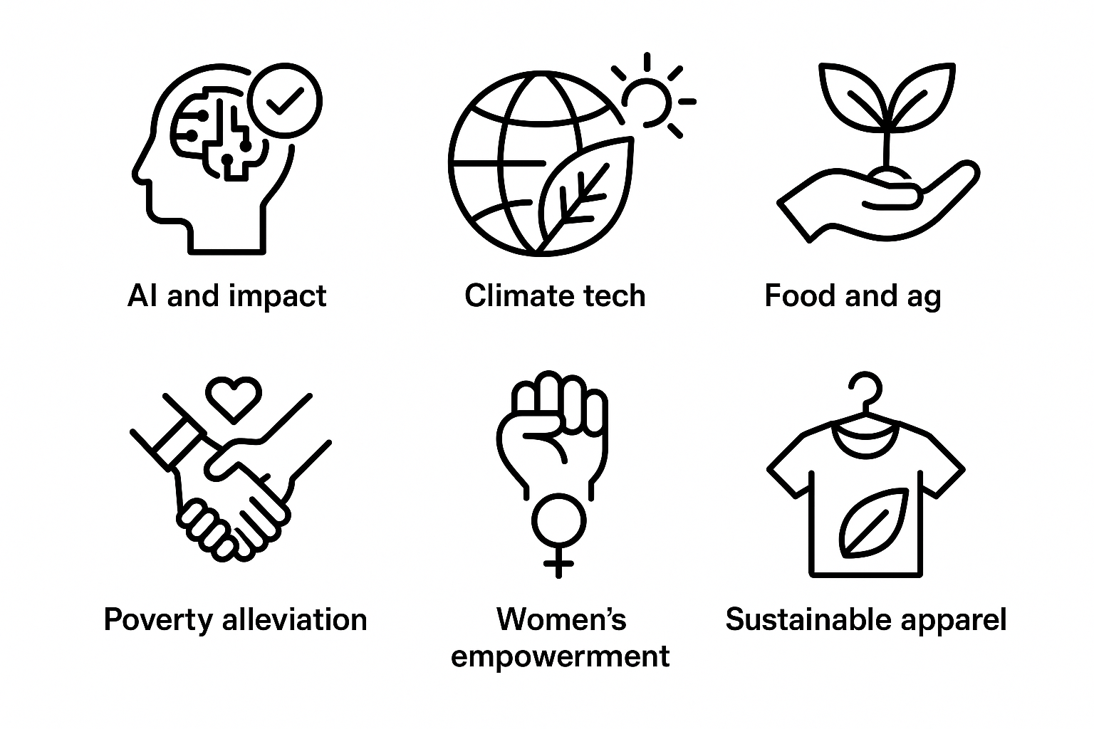
Masterclass content:
10 core modules over two days
Understanding the Field
Developing Your Strategy
Implementing Your Strategy
Engaging the Family
1. What is sustainable and impact investing? History, approaches and trends | 4. Develop a shared family theory of change that links values, impact beliefs, and capital allocation decisions. | 6. Putting money to work I: Leveraging advisors, wealth managers and your own team. | 9. Breaking through gridlock – navigating family dynamics and building consensus around impact
2. Evaluating impact at the investment and company levels? | 5. Where to focus? Selecting investment themes and issue areas for the family * | 7. Putting money to work II: Fund diligence – a framework for evaluating funds on financial and impact potential | 10. Professional and personal development opportunities for the family: how to build investment capacity within the next gen
3. Identifying sustainable strategies across asset classes | 6. Developing a family investment policy – from vision and values to concrete investment strategies. | 8. Pulling it all together: building a mock portfolio and investment proposal using AI
* Optional deep dives on specific impact themes and associated investment opportunities
AI & Impact
Climate Tech
Food & Ag
Poverty Alleviation
Women’s Empowerment
Sustainable Apparel

Slide 7
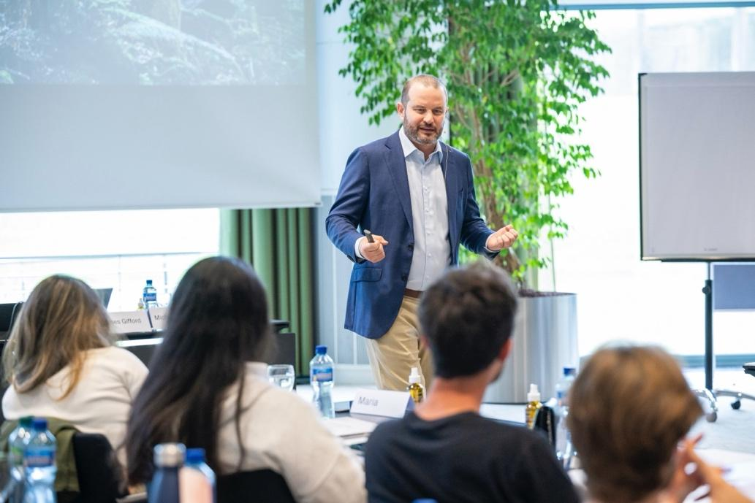
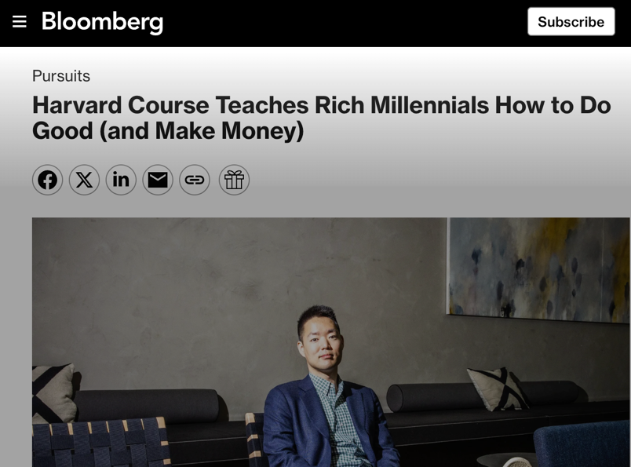
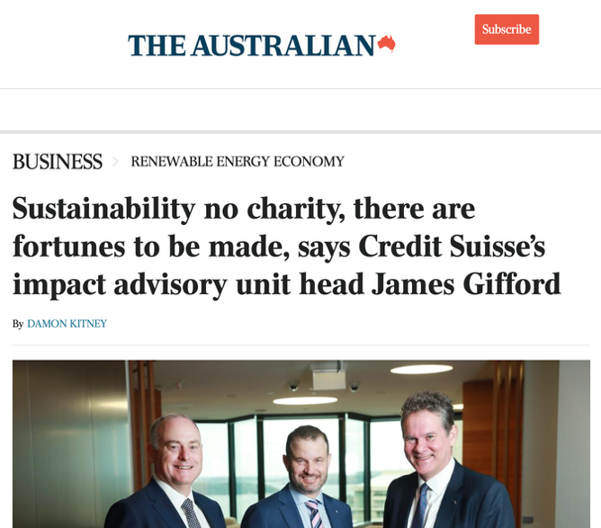
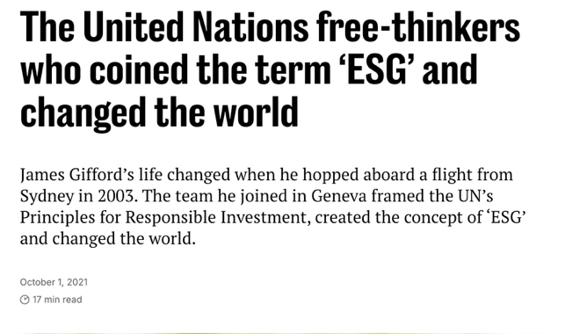
About Dr James Gifford
Dr James Gifford is an independent advisor to UHNW investors and family offices on sustainable and impact investing.
His background includes:
Lecturer at the Centre for Sustainable Finance and Private Wealth at the University of Zurich, where he teaches a joint program with MIT (and formerly Harvard) on impact investing for the next gen of UHNW family members.
Founder and first head of the UN Principles for Responsible Investment (UNPRI), leading the organisation from inception in 2003 until 2013. UNPRI is the largest initiative in sustainable investment globally.
Part of the team at the UN that coined the term “ESG” in 2004.
A PhD on sustainable investing from the University of Sydney.
Head of Impact Investing at Credit Suisse and UBS in their private banking divisions for eight years, supporting UHNW clients and family offices in their sustainable and impact investing journeys.
Direct experience in sustainable apparel, spending three years as Director of Impact at TAU Investment Management, a private equity impact fund working to upgrade garment factories in South and Southeast Asia to become both sustainable and profitable.
Published numerous articles, book chapters and podcast episodes on sustainable and impact investing themes.

Slide 8
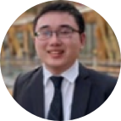

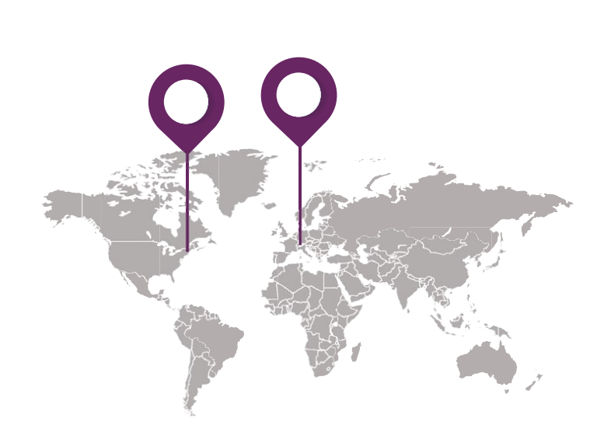
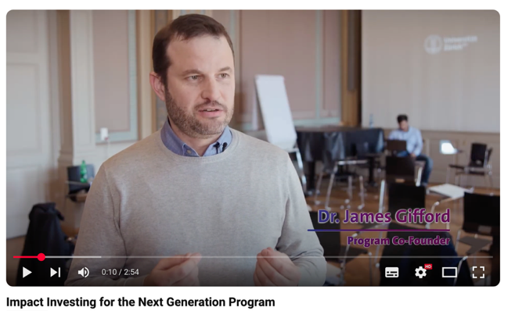
“
MIT-UZH ‘Impact investing for the next generation’ program
The course opened my eyes to the opportunity set within impact investing. I realised it was much broader and less niche than my initial impressions going in. I left excited to explore those potential areas where our family office could help advance.
The proposed workshop above is a customised and shortened version of the seven-day executive program for UHNW next gen at MIT and the University of Zurich, co-founded and taught by Dr Gifford.
This program, in its 11th year, now has over 300 alumni who have collectively deployed> $3 billion into impact investments after completing the course.
Sheng Yang Her
Singapore
Cohort ’18-‘19
Module 1:
October 28–31, 2025 at MIT Sloan, Boston
April 28–30, 2026 at University of Zurich
Module 2:
Website | Brochure
See more on our YouTube channel

Slide 9
Next steps …
We would be delighted to work with your family to deliver a customised and high-impact experience. This proposal is intended as a starting point, and we welcome your input on timing, participants, and priority themes.
To discuss further or confirm availability, please contact:
Dr James Gifford
james.gifford@additionality.co
+41 79 155 7789

